Slide 1
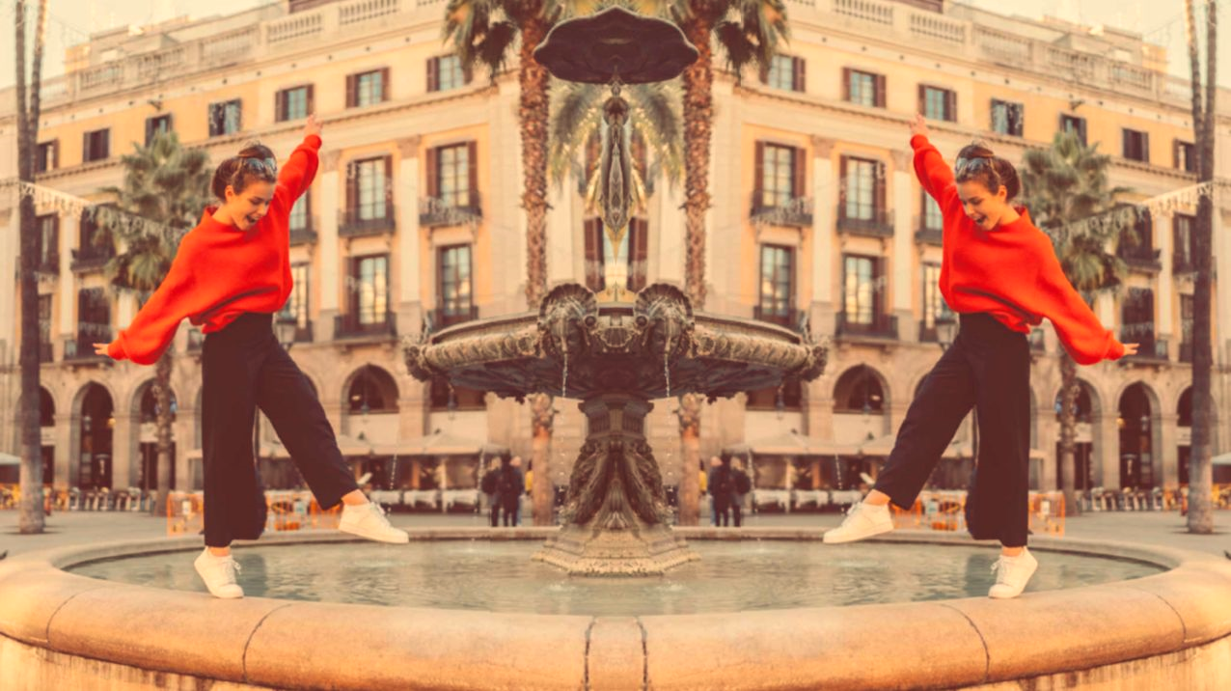
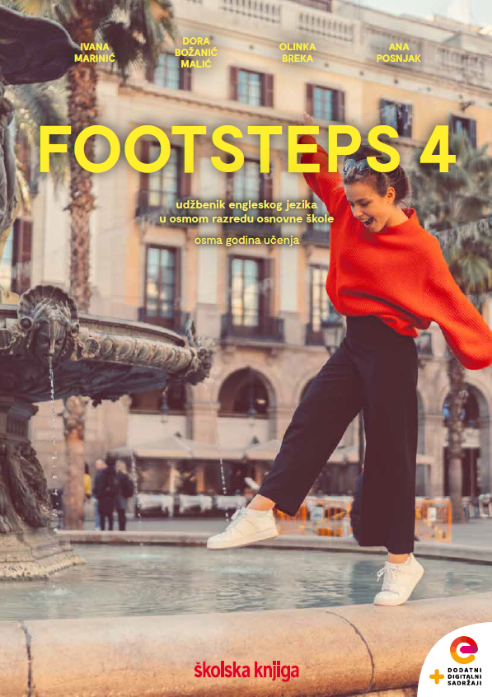

UNIT 2; Inspired
Self-check 2

Slide 3
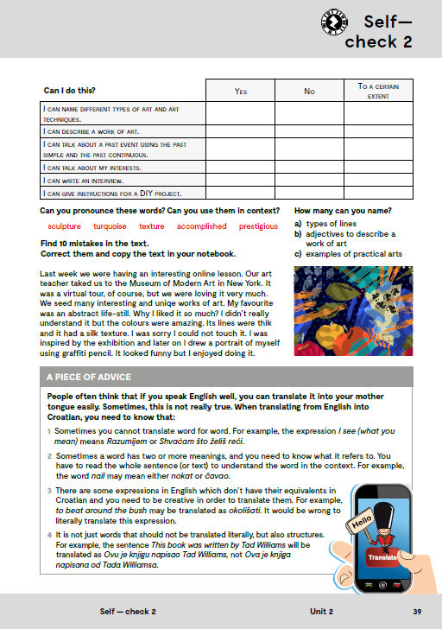
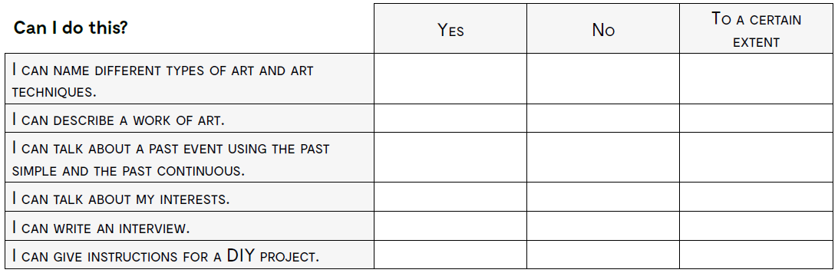
imenovati različite tipove umjetnosti i umjetničke tehnike
opisati umjetničko djelo
govoriti o događajima iz prošlosti koristeći Past Simple i Past Continuous
govoriti o vlastitim interesima
napisati intervju
dati upute za Uradi sam projekt

Slide 4

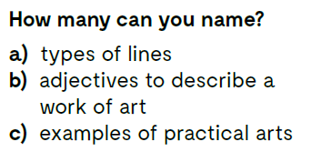

Slide 5
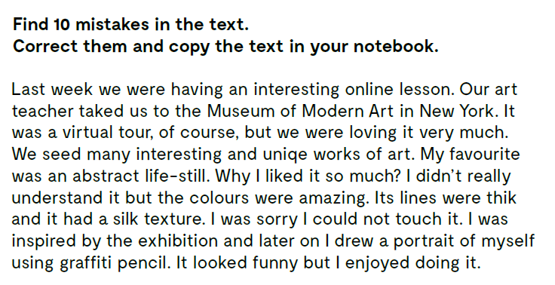
Last week we had an interesting online lesson.
Our art teacher took us to the Museum of Modern Art in New York.
It was a virtual tour, of course, but we loved it very much.
We saw many interesting and unique works of art.
My favourite was an abstract still-life.
Why did I like it so much? I didn’t really understand it but the colours were amazing.
Its lines were thick and it had a silky texture. I was sorry I could not touch it.
I was inspired by the exhibition and later on I drew a portrait of myself using graphite pencil. It looked funny but I enjoyed doing it.

Slide 6
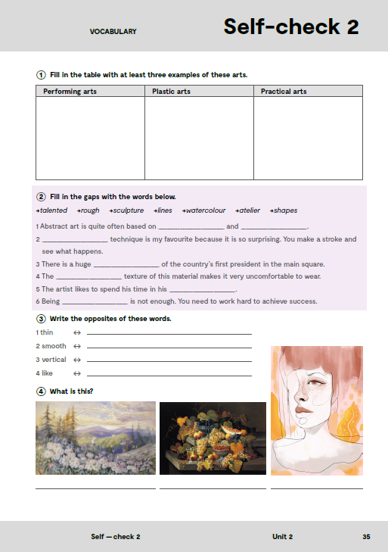
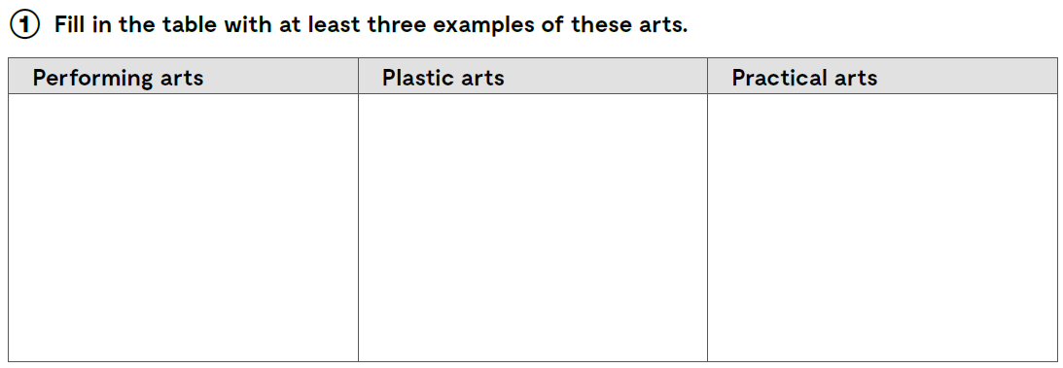
music
dance
drama
sculpture
ceramics
painting
needlework
woodwork
pottery

Slide 7

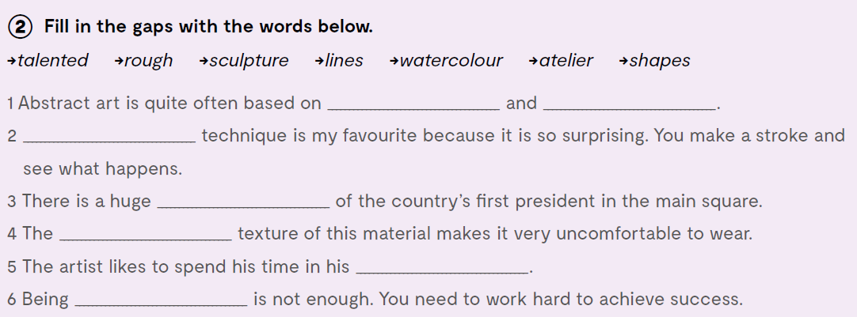
lines
shapes
Watercolour
sculpture
rough
atelier
talented

Slide 8
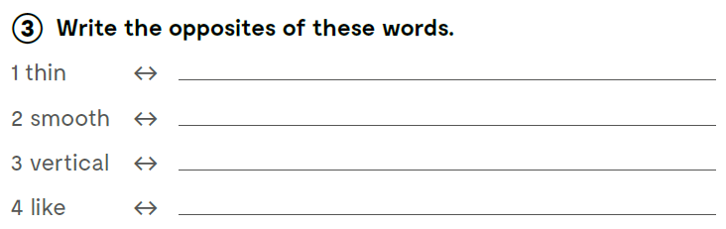
thick
rough
horizontal
dislike
Check what you have learnt:
https://wordwall.net/play/12637/639/580

Slide 9
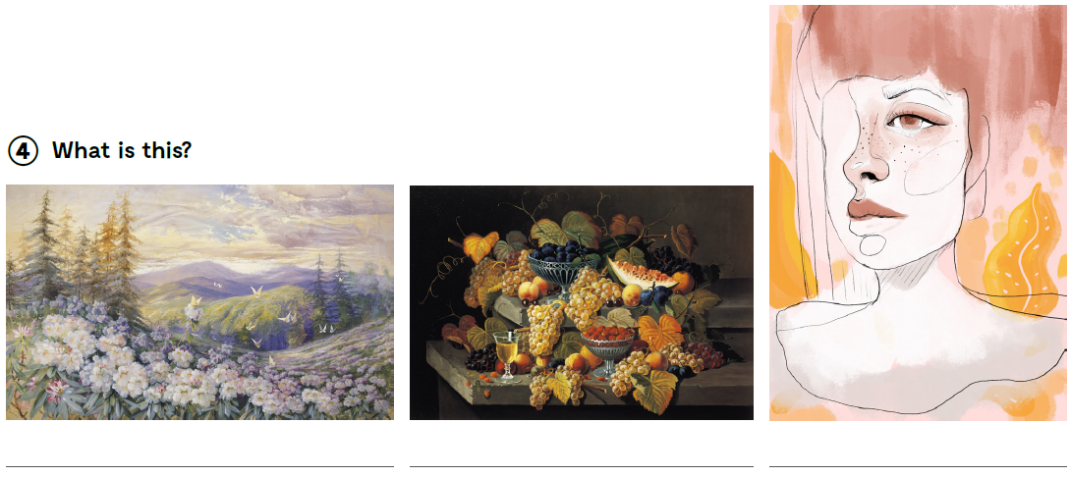
a landscape
a still-life
a portrait

Slide 10
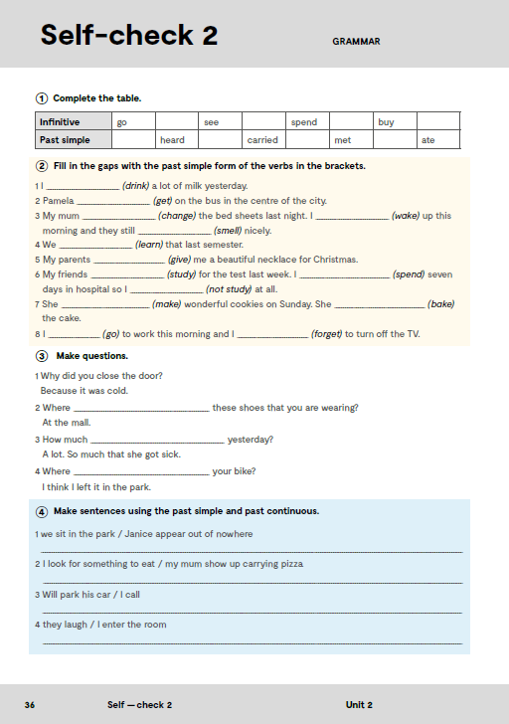
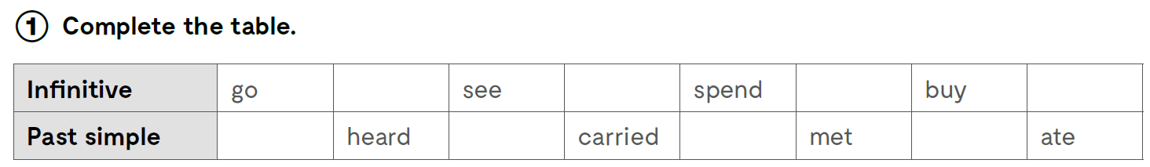
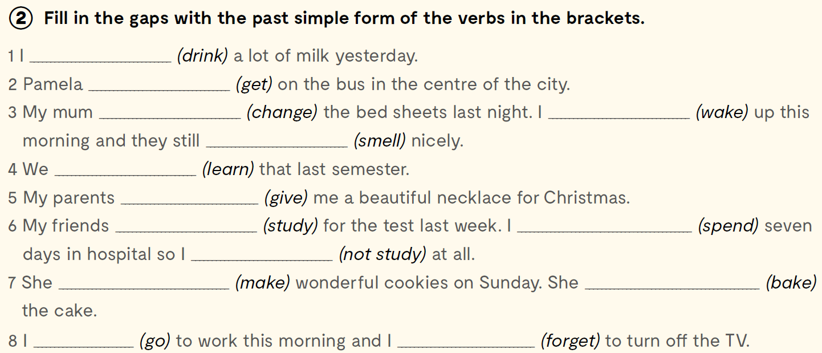
hear
carry
meet
eat
went
saw
spent
bought
drank
got
changed
woke
smelt
learnt
gave
studied
spent
didn’t study
made
baked
went
forgot

Slide 11
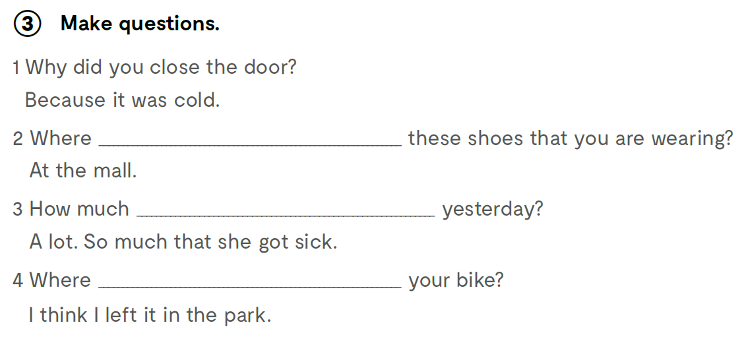
did you buy
pizza did she eat
did you leave

Slide 12
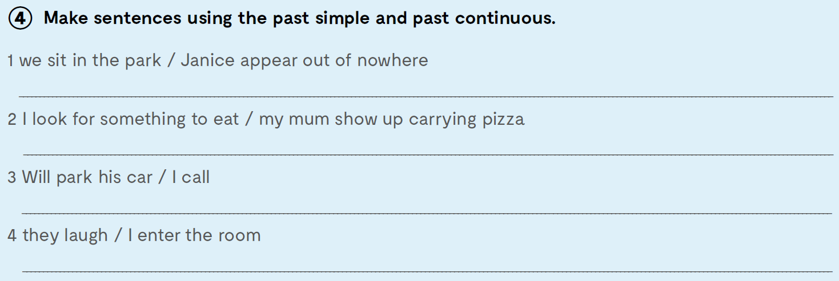
We were sitting in the park when Janice appeared out of nowhere.
I was looking for something to eat when my mum showed up carrying pizza.
Will was parking his car when I called him.
They were laughing when I entered the room.

Slide 13
